Slide 1






\
Deep sediment characterization from very
low-frequency features from merchant ships
Alexandra M. Hopps-McDaniel
D. P. Knobles, Tracianne B. Neilsen, Preston S. Wilson, William S. Hodgkiss, and Jason D. Sagers
Acoustical Society of America | Ottawa, CA | May 2024
Notes:
Thank you! I am happy to be here! A little background about myself… I started this analysis as an undergrad at BYU. Since graduating, I have been working with David Knobles at Knobles Scientific and Analysis.

Slide 2
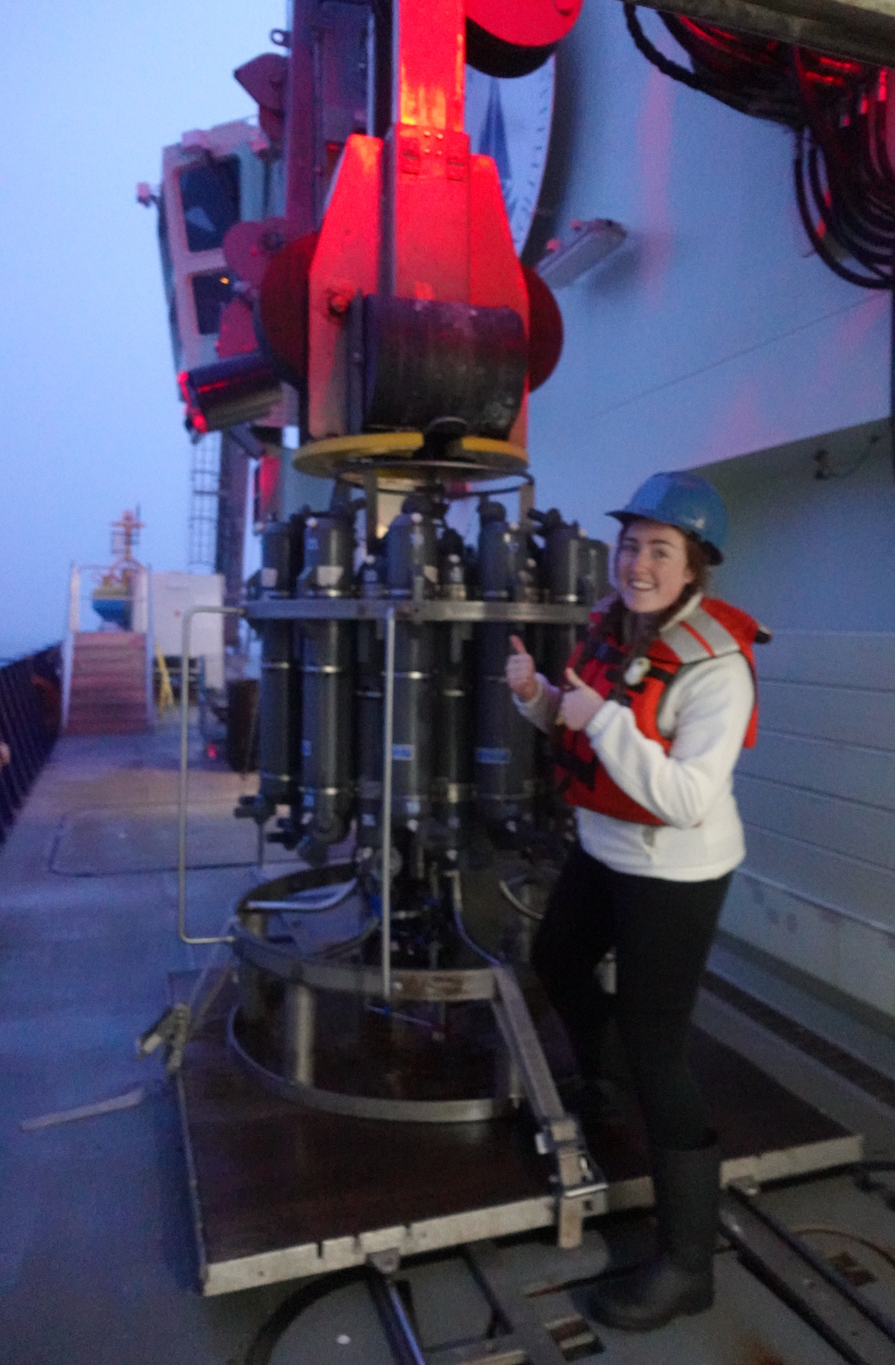
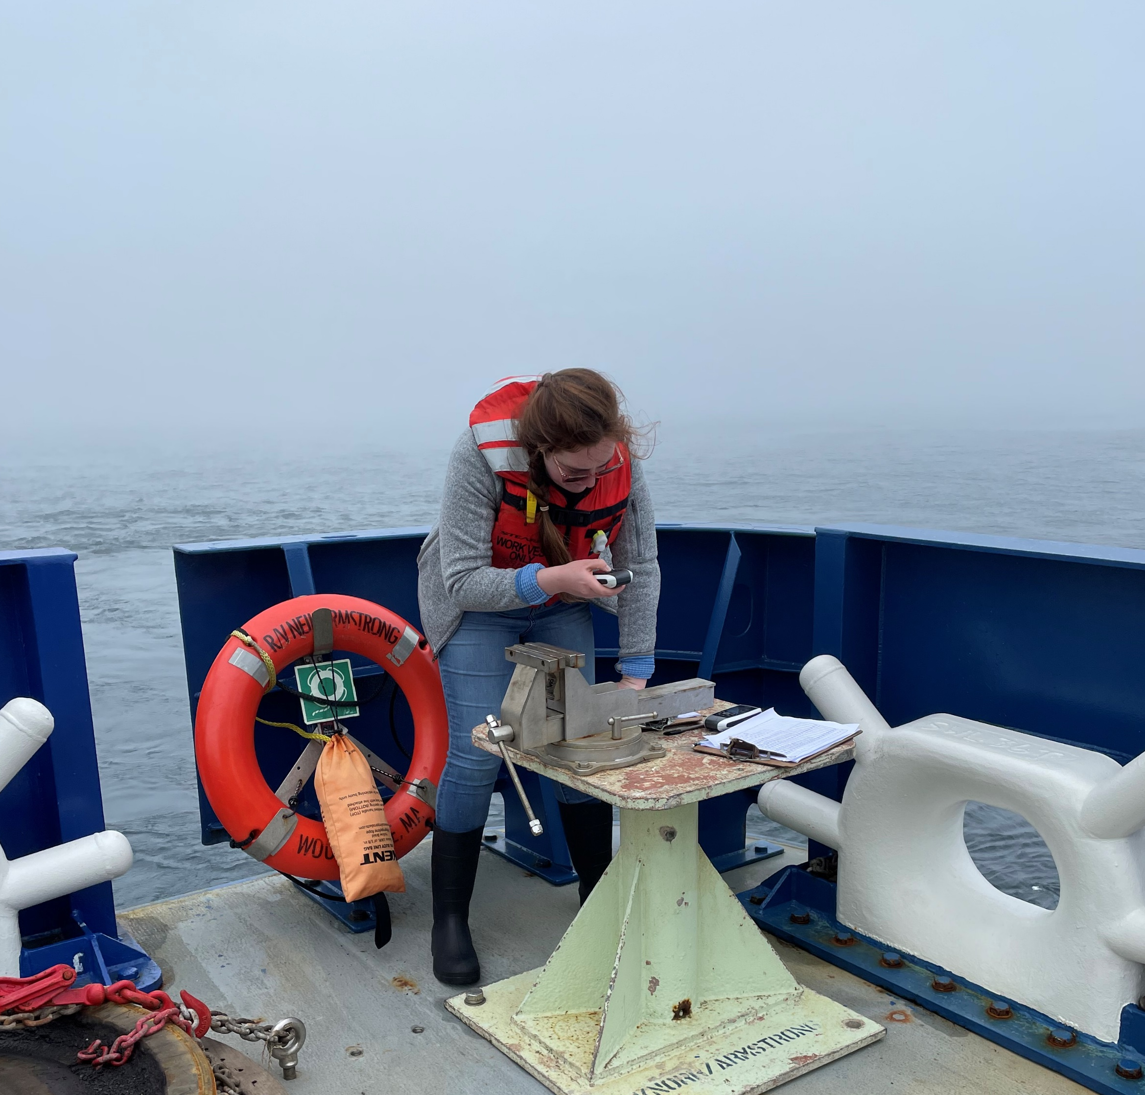

\
Brigham Young University
Bachelors in Applied Physics 2023
Knobles Scientific and Analysis
Research investigator 2023-2024
University of Wyoming
Masters of Electrical Engineering starting Fall 2024
Notes:
Thank you! I am happy to be here! A little background about myself… I started this analysis as an undergrad at BYU. Since graduating, I have been working with David Knobles at Knobles Scientific and Analysis.

Slide 3
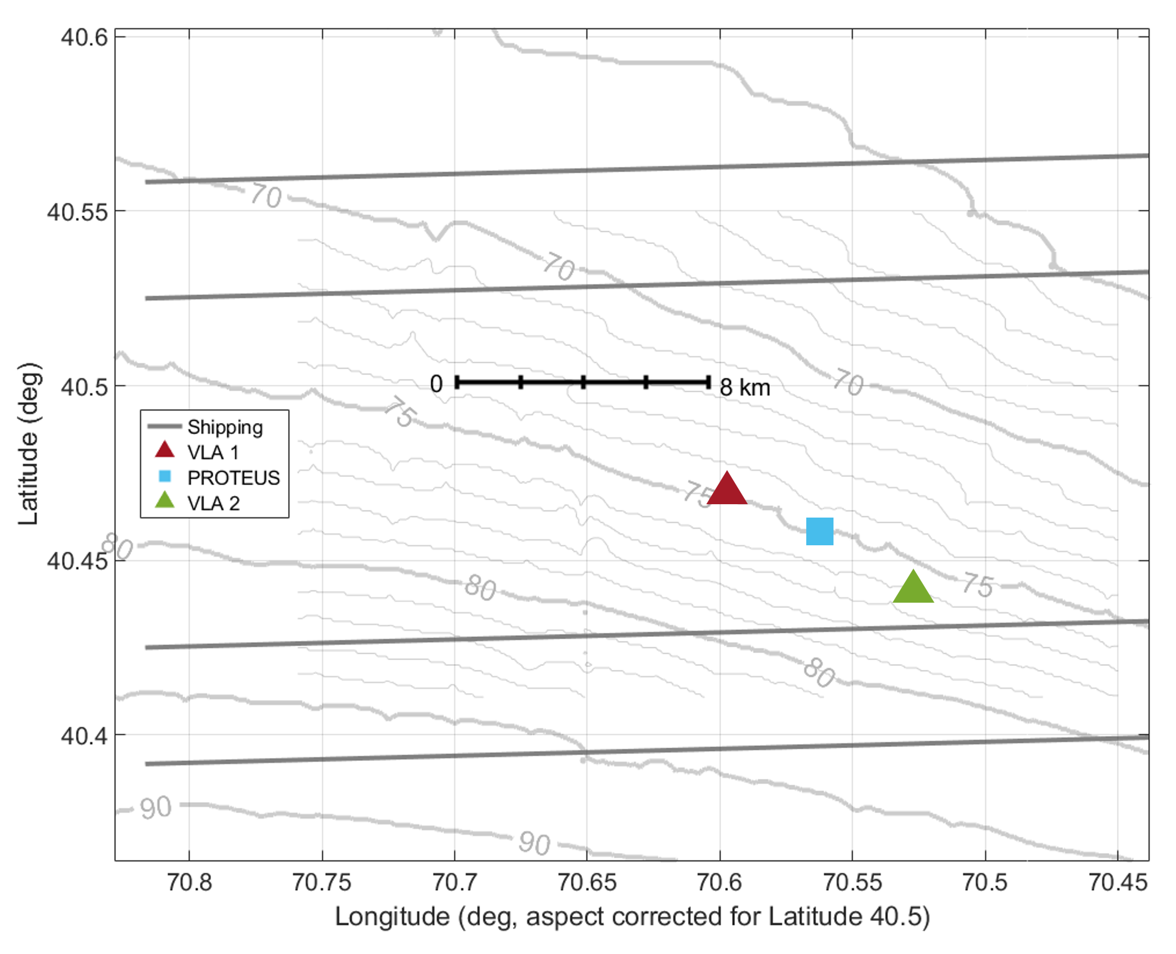
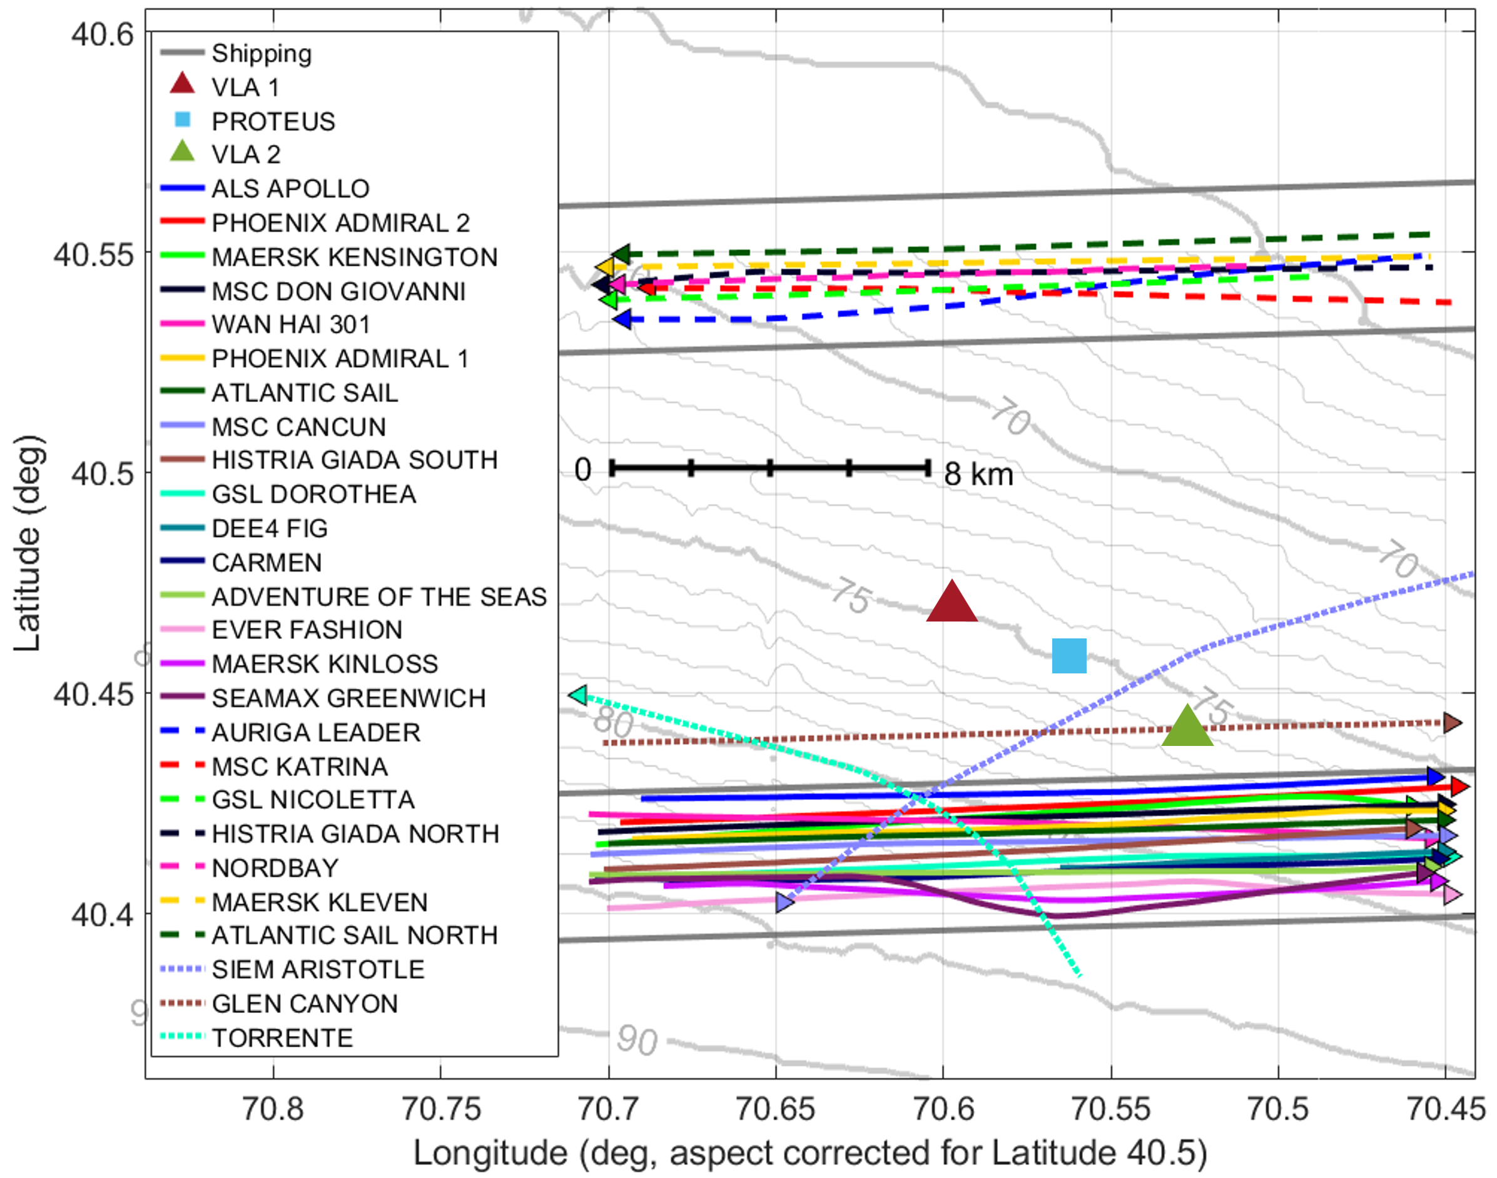
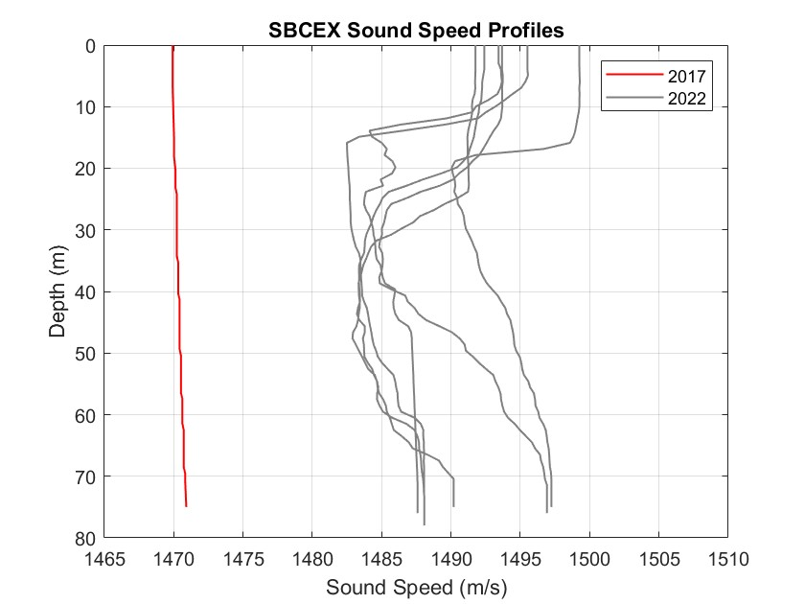
Seabed Characterization Experiment
Geographical area along the New England Continental Shelf
Three vertical line arrays
Scipps:MPL VLA 1 & 2
ARL:UT PROTEUS
Water depth: ~ 75 m
Mud thickness: ~ 9.2 m
24 ships of interest
NORTHERN LANE
SOUTHERN LANE
Notes:
The seabed characterization experiment is an experiment that took place along the New England Continental Shelf, which is called the New England Mudpatch.
Add information on the distance between the ships and the lanes
There were two experiments done under this project, one in 2017 when there were isovelocity water conditions and one in 2022 where the water column varied greatly.
The data from this analysis comes from the Seabed characterization 2022.
In the Mudpatch, the thickness of the mud varied widely, but along the thickest part were placed three VLAs. The two on the outsides are VLA 1 and 2 and were deployed for 3 days. PROTEUS was deployed for 28 days.
The avg. water depth was about 75 m here, and the mud thickness about 9.2 m.
These arrays were place strategically in this location because they are between two shipping lanes, a northern and a southern one.
For this analysis, I am going to focus on 24 ships that passed through the area which fall into three categories of travel: through the southern lane, northern lane, and three which has other tracks.
Some ships passed through the area multiple times like the phoenix admiral which had travel twice in the southern lane and the histria Giada and Atlantic sail which traveled in both the northern and southern shipping lane.
Add the distance to the lanes from arrays

Slide 4
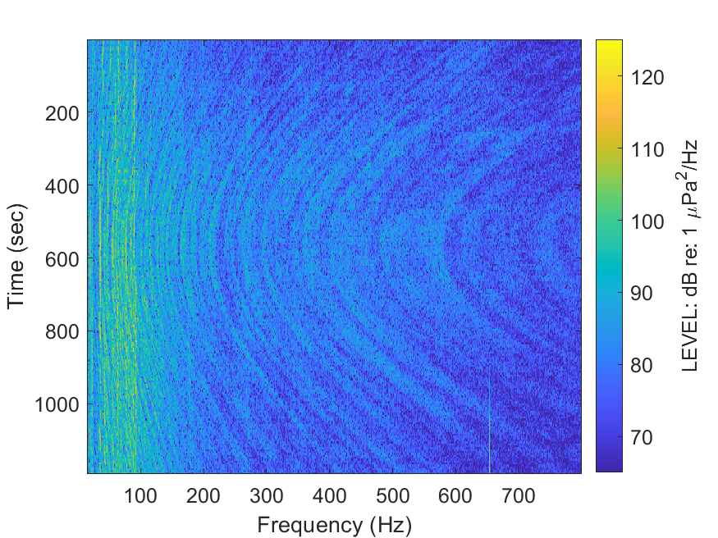
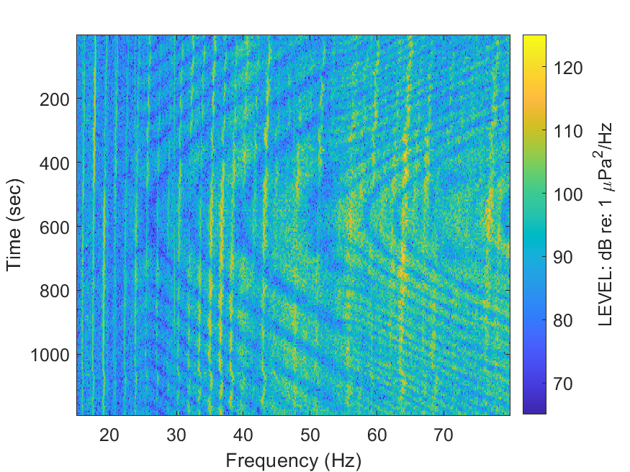
Ship spectrograms
Nested striation pattern
Centered at the closest point of approach (CPA)
Very low-frequency (VLF) spectrograms in the Mudpatch: 20-80 Hz
Observe unique acoustic features
CPA
Notes:
Ship spectrograms are characterized by a nested striation pattern from the interference of different modes. On the right is a time-frequency spectrogram centered around the closest point of approach of the ship.
In the mudpatch, the VLF specs thatwe are looking at are from 20-80 hz because these frequencies can reach the deep sediment layers of the seabed and also because we observe unique acoustic features in the shape of an x.
Before I can talk about these singular points in greater detail, I have to define something called the waveguide invariant (beta)

Slide 5


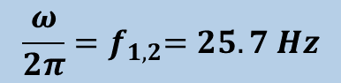
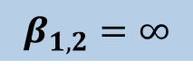
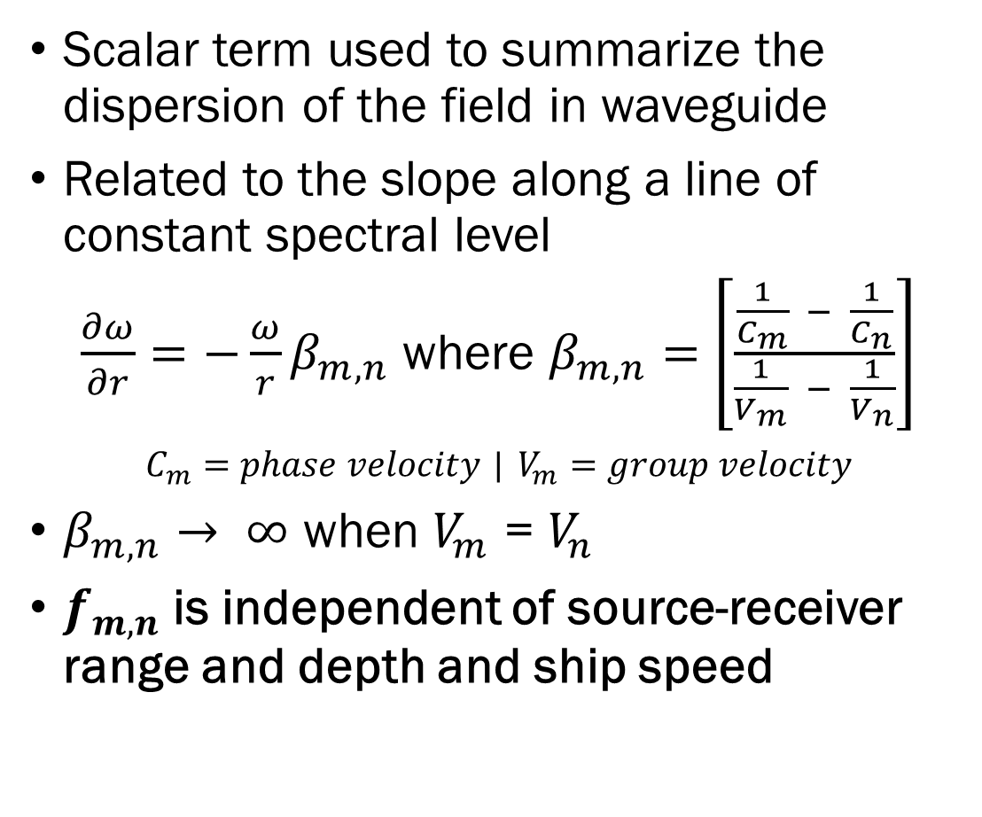

Waveguide invariant (𝛽 )
Scalar term used to summarize the dispersion of the field in waveguide
Related to the slope along a line of constant spectral level
$\frac{∂ω}{∂r}=−\frac{ω}{r}β_{m,n}$ where $β_{m,n}=$ $\left[\frac{\frac{1}{C_{m}} − \frac{1}{C_{n}}}{\frac{1}{V_{m}} − \frac{1}{V_{n}}}\right]$
$C_{m}=phase velocity$ | $V_{m}=group velocity$
$β_{m,n}→ ∞$ when $V_{m}$ = $V_{n}$
$f_{m,n}$is independent of source-receiver range and depth and ship speed
Angular Frequency $(ω)$
$$\frac{ω}{2π}{=f}_{1,2}=25.7 Hz$$
$$β_{1,2}=∞$$
Range $(r)$
Time $(sec)$
For more information, see: C. Verlinden, J. Sarkar, B. D. Cornuelle, and W. A. Kuperman, “Determination of acoustic waveguide invariant using ships as sources of opportunity in a shallow water marine environment,” The Journal of the Acoustical Society of America 141(2), EL102– EL107 (2017).
Notes:
It is a scalar term used to describe the dispersive characteristics of a waveguide and related to the slope along a line of constant spectral level in frequency-time spectrogram
Here is a rotated spectrogram and you can see that if you were to go down this striation, the slope of the line at the vertices would be zero.
The equation of this slope is related to beta, which is the dif in the phase velocity over the difference of ground velocities
You can see that when the ground velocities of two modes are equal that beta goes to infinity
It turns out that the x-shaped pattern is where that happens, you can see the infinite slope
The frequency where this occurs is labeled at fmn
This value is indep of range, depth, and ship speed

Slide 6
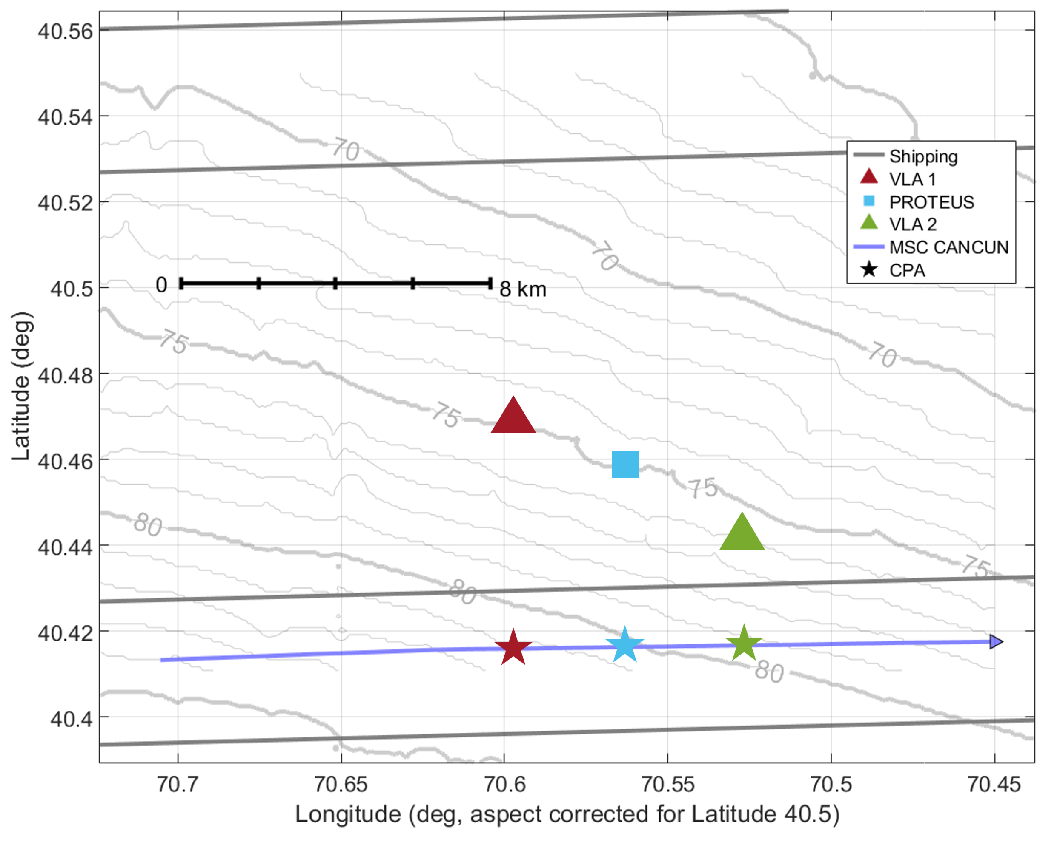
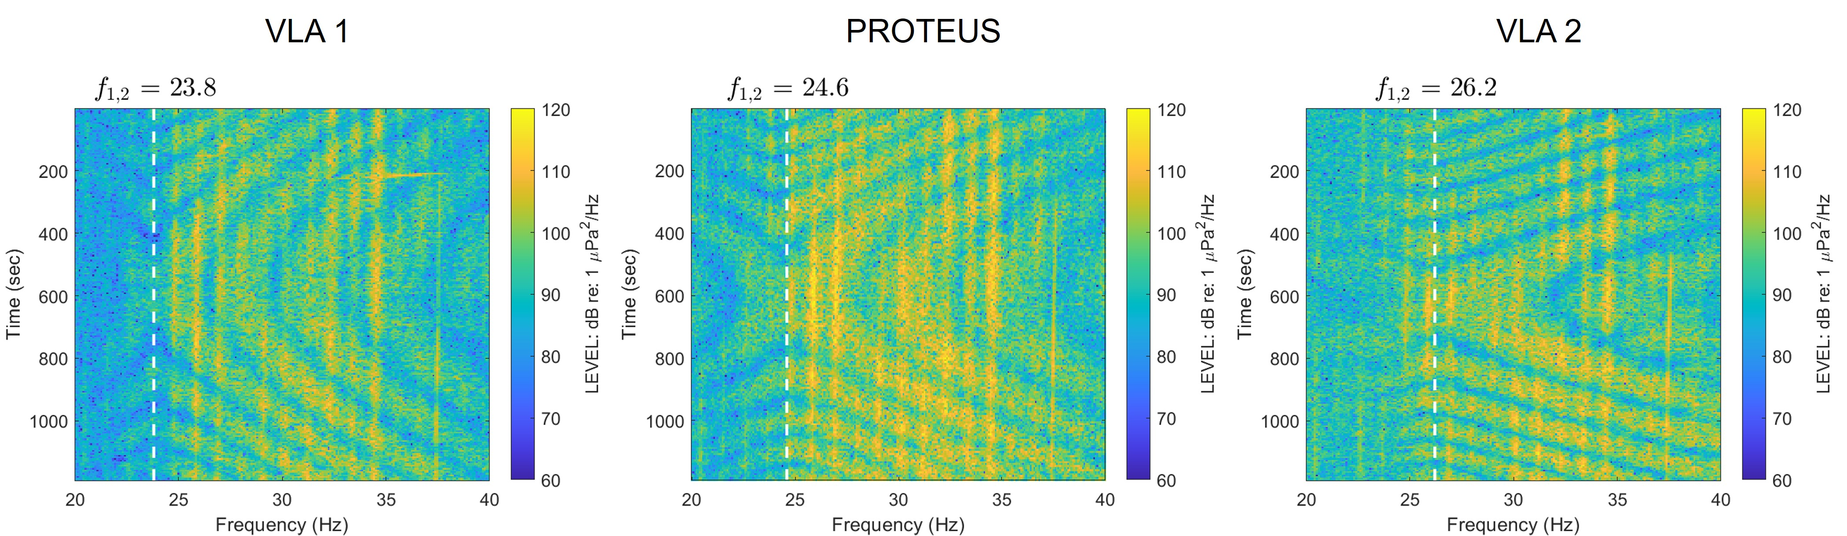
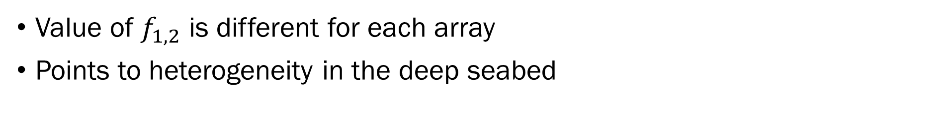
Container Ship MSC CANCUN
Value of $f_{1,2}$ is different for each array
Points to heterogeneity in the deep seabed
Notes:
Take the container ship msc cancun for example.
It traveled through the southern shipping lane where the stars indicate the location of the ship at cpa to each of the arrays
From each array we observe the b=infinity points and the associated f12 values, but there is a gradual difference in the frequencies.
Since beta only depends on environment, this was our first indication of deep layer heterogeneity in the seabed

Slide 7
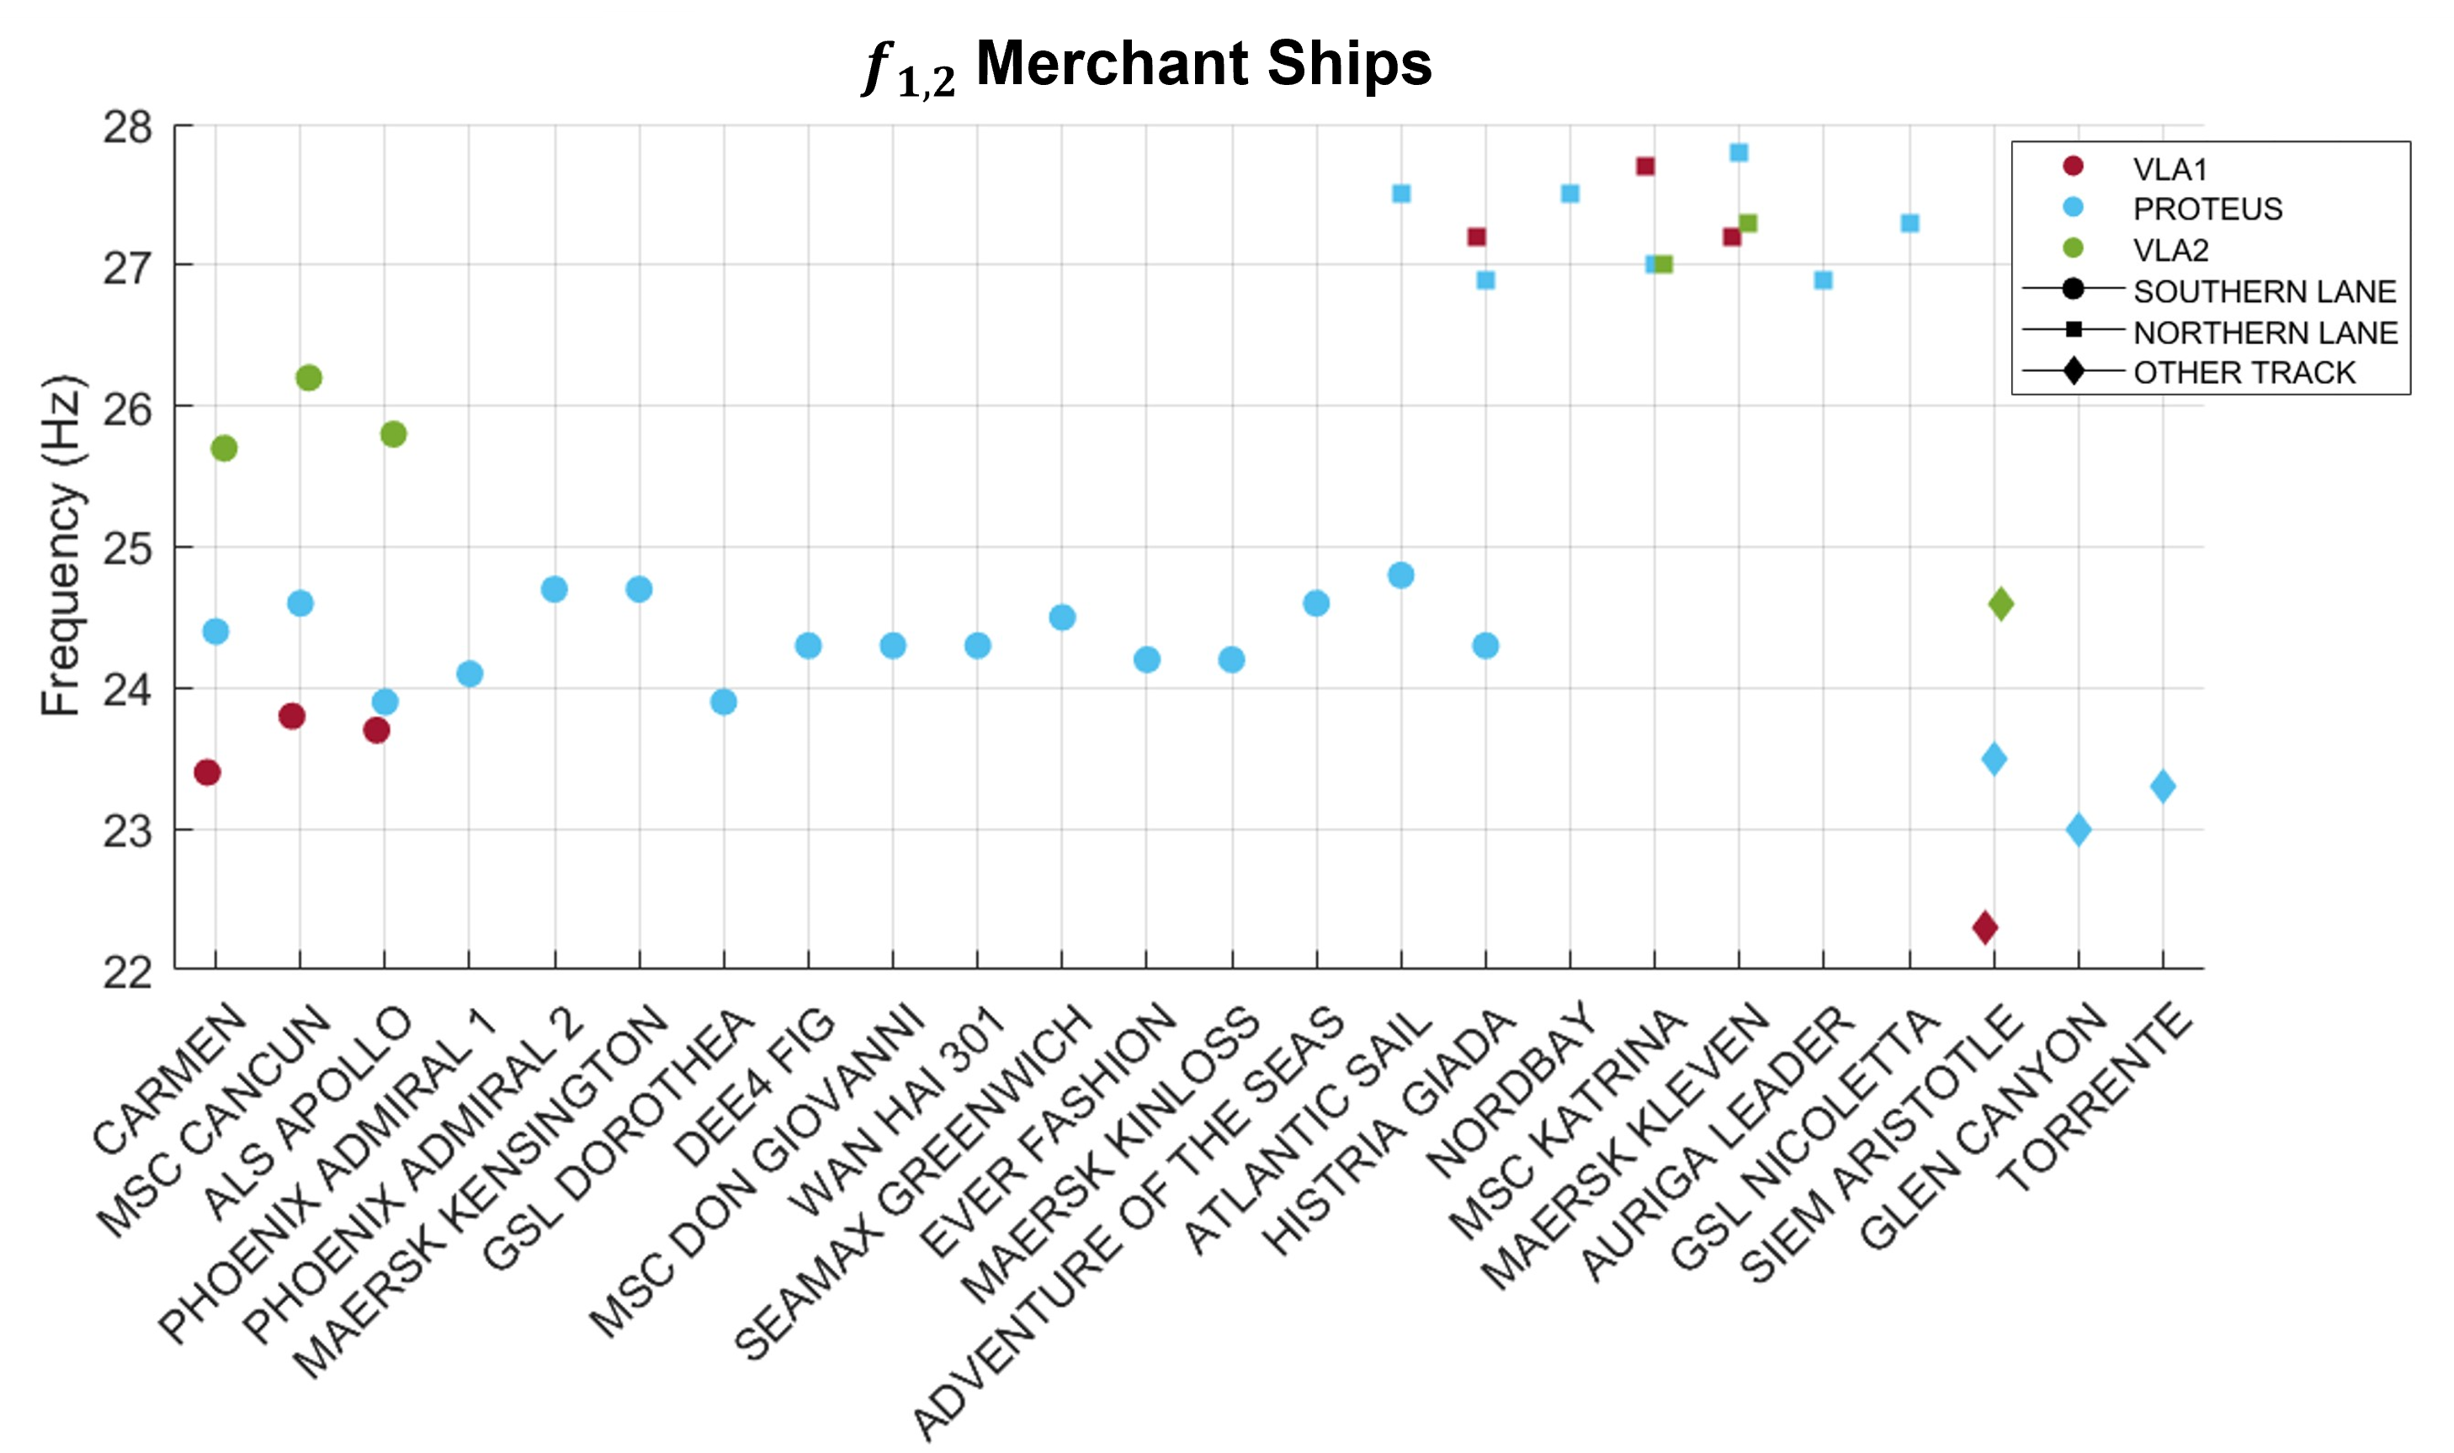
$f_{1,2}$ values for each ship
Three distinct clusters in the singular points based on ship track
Three groupings for ships in the southern lane associated with the three acoustic arrays
Northern Tracks
Other Tracks
Southern Tracks
Notes:
Some ships had as many as three b=infinity points associated with modes 1-4
Here is shown the f12 values for all 24 ships of interest
There are three distinct clusters based on the track of the ship
Furthermore, there are three groupings within the southern shipping lane based on which line area
These are all indication that the deep sediment layers vary spatially

Slide 8
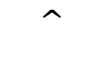
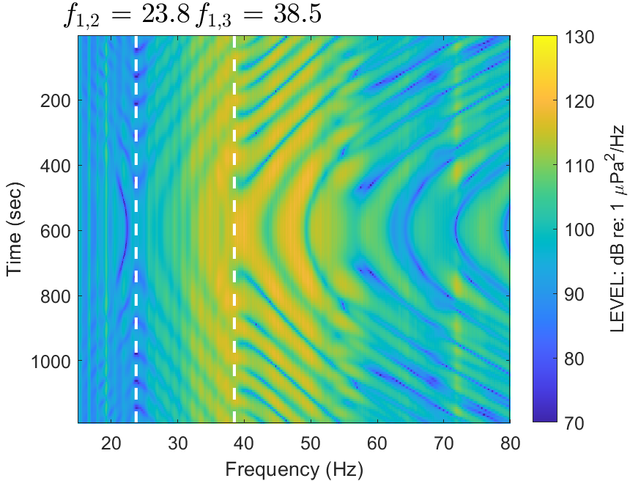
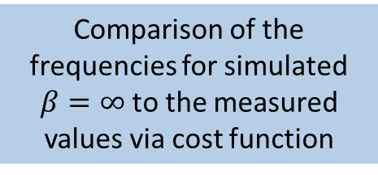
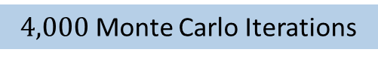
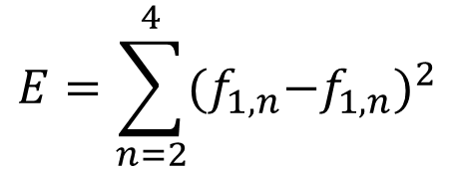
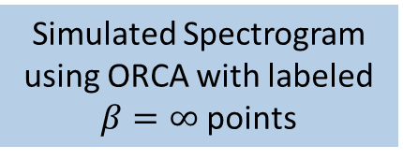
Maximum entropy inversion
Prior Model of Seabed :
Sediment layers
Water column data
Ship track
Comparison of the frequencies for simulated $β=∞$to the measured values via cost function
Simulated Spectrogram using ORCA with labeled
$β=∞$points
 | Thickness (m) | Sound Speed (top) (m/s) | Sound Speed (bottom) (m/s) | Density (km/m³) | Attenuation [dB/(m/kHz)]
Mud | 9.2 | 1445 | 1446 | 1.62 | 0.04
Transition | 3.0 | 1446 | 1750 | 1.80 | 0.15
Sand | 7.5 | 1750 | 1750 | 1.83 | 0.15
DL1 | [50, 300] | [1700, 1810] | DL1_SS_{top} | 2.00 | 0.15
DL2 | [50, 300] | [1815, 2050] | DL2_SS_{top} | 2.20 | 0.15
DL3 | 100.0 | 2100 | 2100 | 2.20 | 0.15
Basement | -- | 2350 | 2350 | 2.60 | 0.22
$$E=\sum_{n=2}^{4}{{{(f}_{1,n}−f_{1,n})}^{2}}$$
$4,000$ Monte Carlo Iterations
Output:
Modeled spectrogram with parameters that provided lowest cost function
Notes:
The frequencies where beta equals inf were used as features in a maximum entropy inversion.
For this, we used a prior model of the seabed for sediment layers, water column data, and ship tracks.
The first three layers and the bottom two layers were all held fixed based. The top 18 m has been extensively studied and is based on information from surveys and geoacoustic inversions in the 100 kHz band. The thickness of the mud and water column data are based on the environment of the array which were placed in the thickest part of the mud.
The thickness and sound speed of the first two deep layers were allowed to vary, where the brackets indicate the upper and lower bounds.
Using ORCA, we were able to come up with a simulated spectrogram with labeled beta=inf points.
The frequencies for the beta=inf points were then compared via a cost function.
We did this for 4000 monte carlo iterations and the result was a modeled spectrogram that provided the lowest cost for the four parameters.

Slide 9
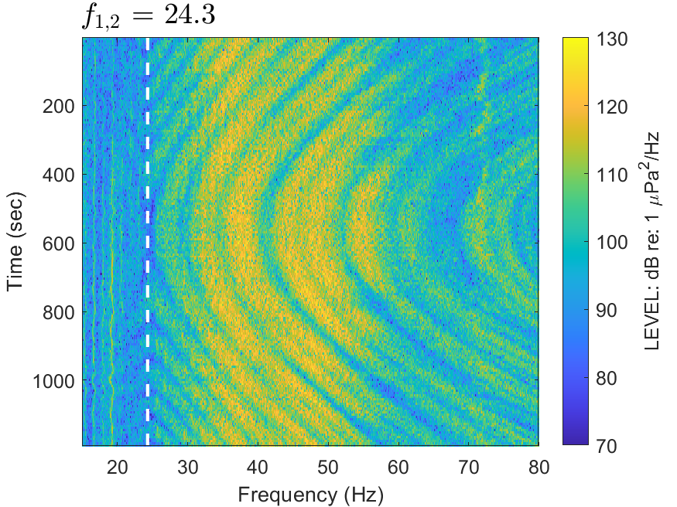
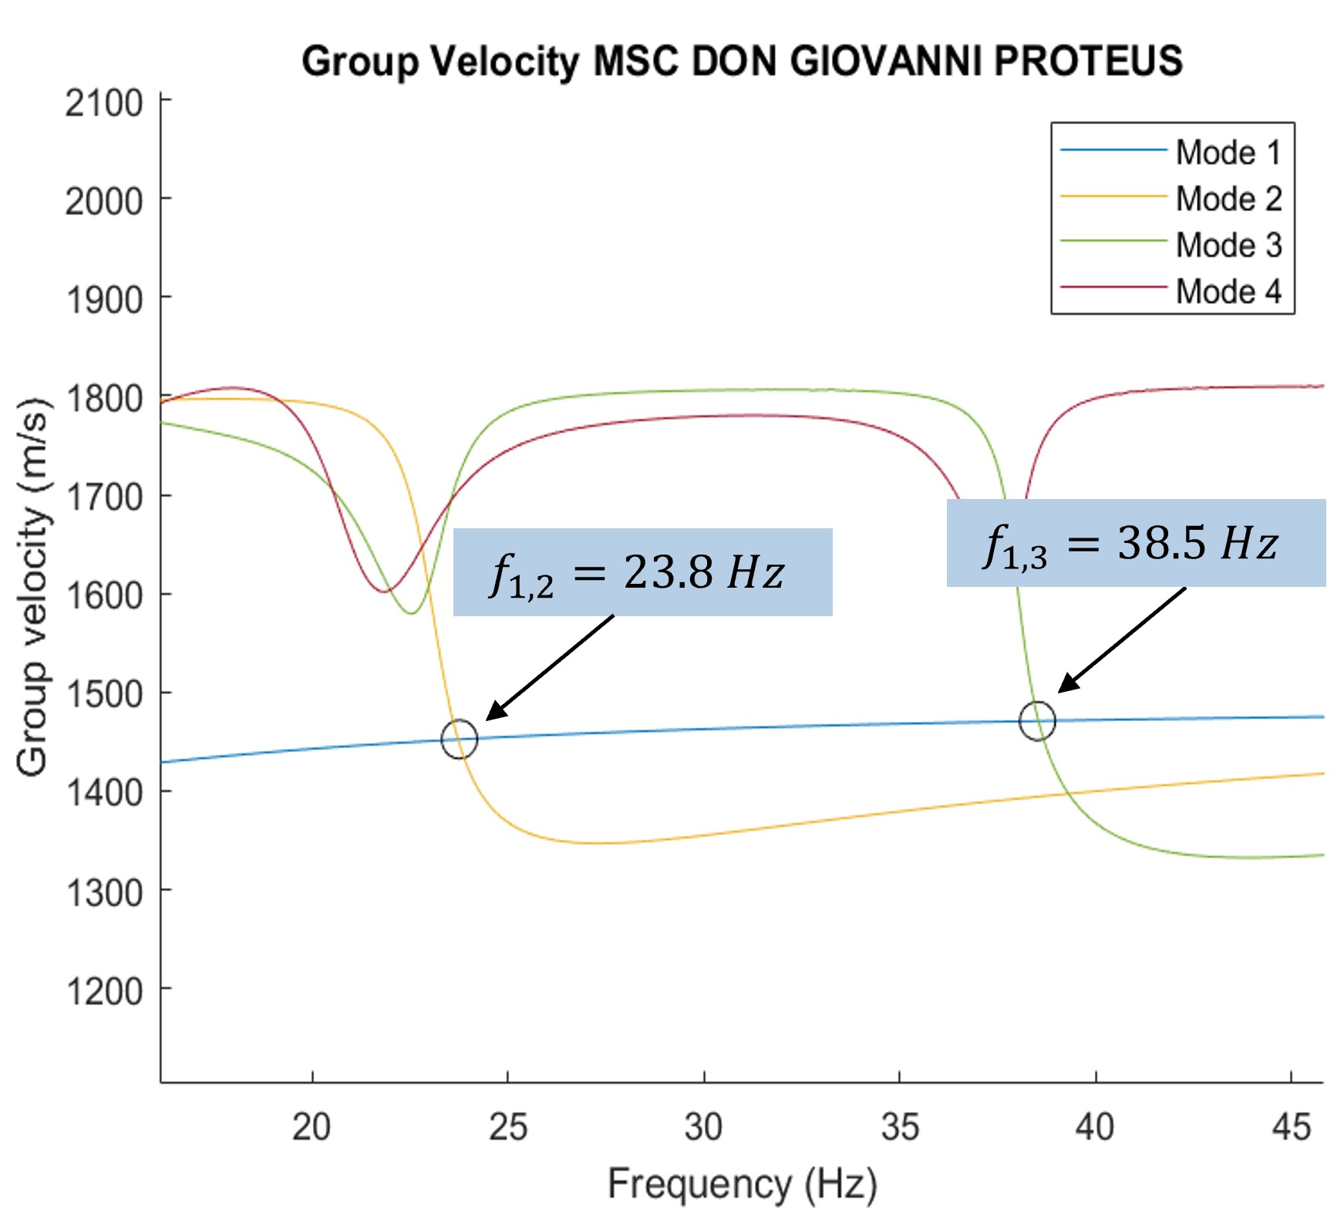
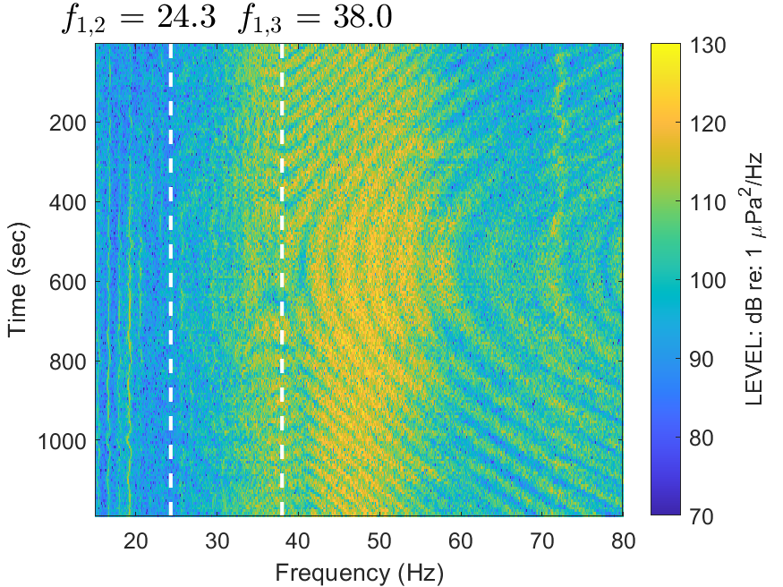
MSC DON GIOVANNI
MEASURED
MODELED
Different channels from the measured data show singular points with varying clarity
Modeled spectrogram shows all singular points
Plot of group velocities show that frequencies where modes cross matches frequencies of singular points
CH17
CH17
GROUP VELOCITY
CH11
Notes:
The MSC DON GIOVANNI was a ship in the southern shipping lane.
Though beta is depth dependant, you can see that it was necessary to look at all channels to identify all beta=inf points. This is because at certain depths, some modes are at nulls and the related singular point for that mode pair is not as clear.
In this case, you can see that f1,3 is only clear on channel 11.
The maximum entropy method comes up with a modeled seabed environment with the two deep layers that return the lowest cost function. The modeled spectrogram is shown on the right, and you can see that the observed singular points closely match the measured data.
A plot of the group velocities for modes 1-4 confirm that the frequencies where pairs of modes cross match the singular points.

Slide 10
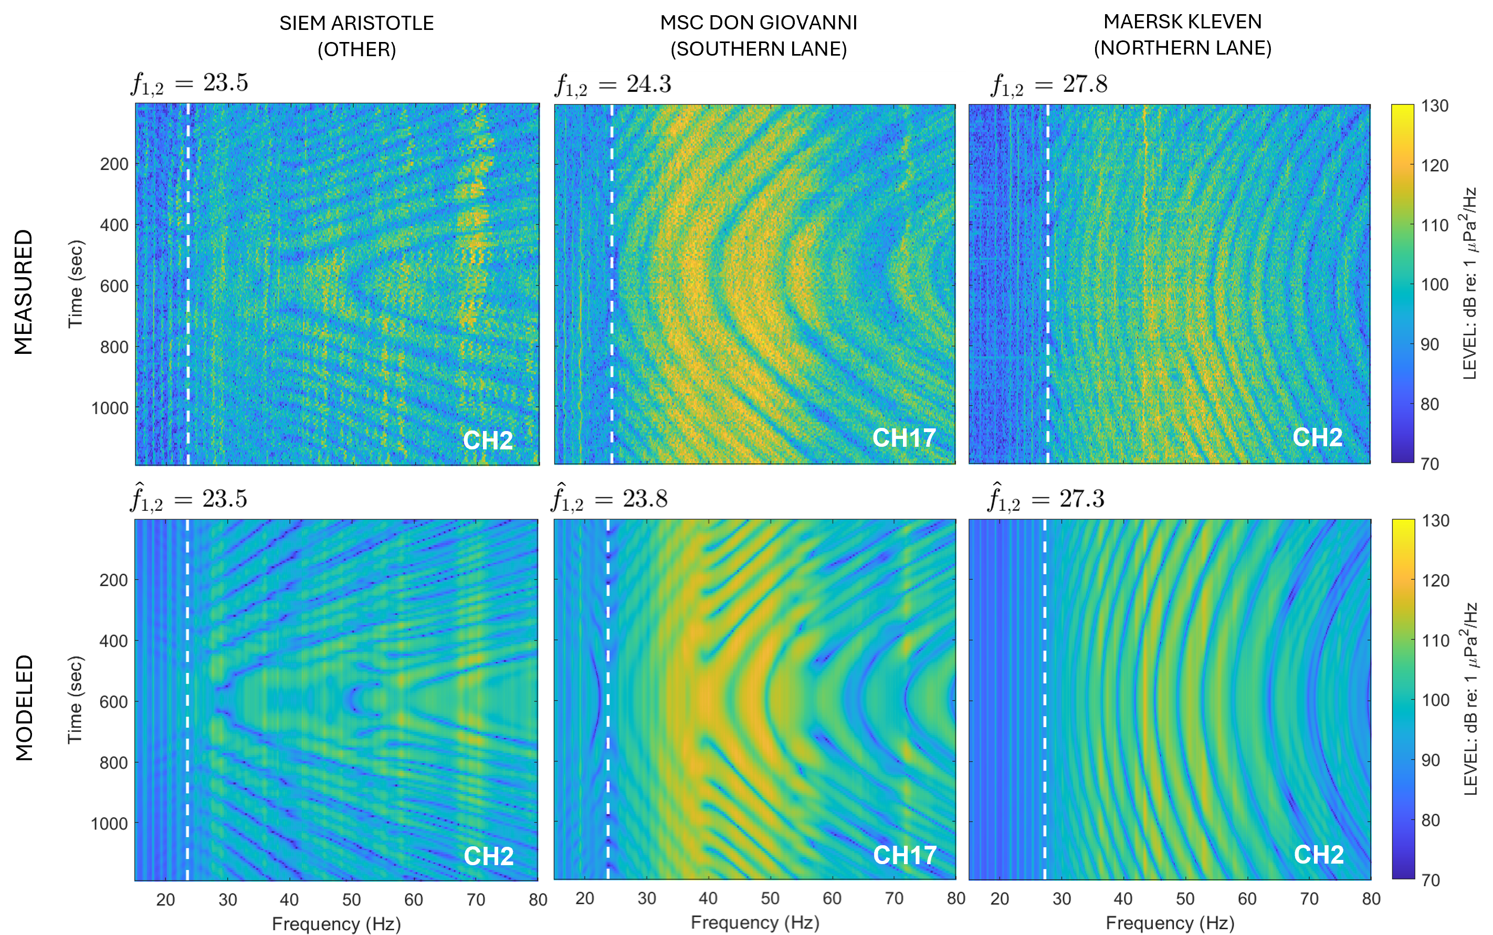
Measured vs. modeled for different ship tracks
Notes:
This method was done for all 24 ships. This slide shows a comparison of the measured and modeled spectrograms for three ships traveling through the three lane categories.

Slide 11
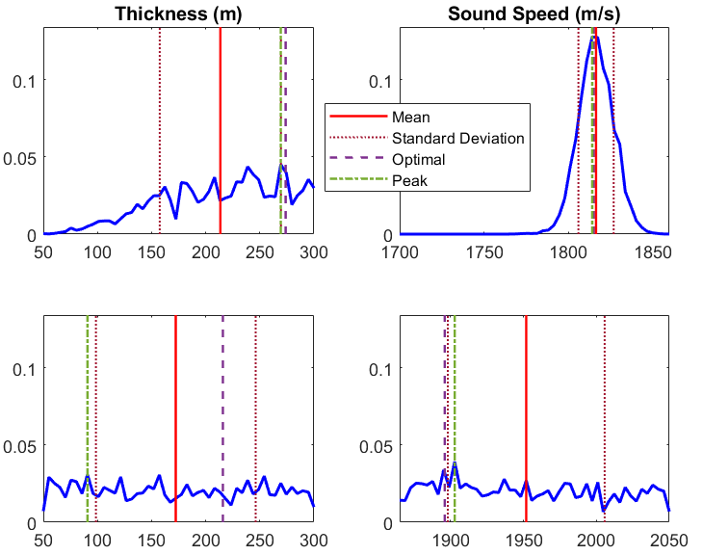
Marginal probability distributions
Sound speed of the first deep layer is the only informative parameter
Consistent for all ships
Lower limit of the thickness ~ 175 m
DL1
MSC DON GIOVANNI
DL2
Notes:
Marginal probability distributions provide information on which of the four parameters can be inferred. The sound speed of the first deep layer is the only informative parameter.
This was consistent across all ships.
For this case, you can also see a lower limit on the thickness of the first deep layer due to the asymmetric distribution, setting a lower limit of about 175m.
Noise covariance: it’s related to the minimum of the cost, using an analogy with the equi-partition theory and statistical mechanics

Slide 12
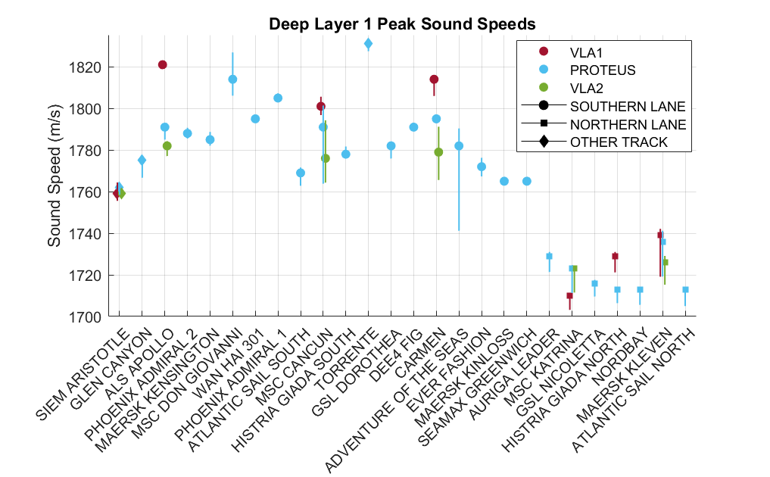
Deep layer sound speeds
Ships are ordered from closest to farthest from PROTEUS
Bars indicate the standard deviation of the marginal probability distribution
Distinguishable clusters
Notes:
Here I have a plot that shows the first deep layer sound speeds of all 24 ships.
In this case, the ships are ordered from closest to farthest from PROTEUS and have error bars that indicated the standard deviation of the marginal probability distribution.
In conjunction with the previous beta=inf plot, the sound speeds are grouped based on ship track with the deep layer sound speeds from the southern ships much higher than the northern lane ships.

Slide 13
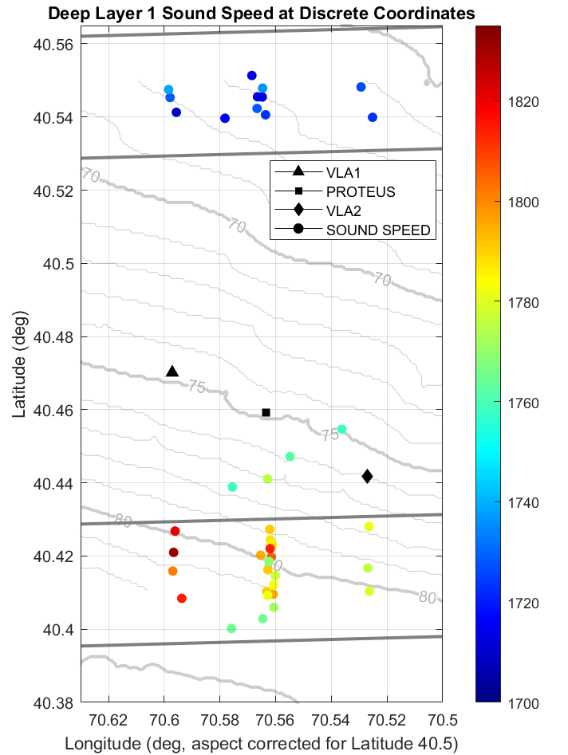
Heterogeneity in the seabed
Deep layer sound speeds at the CPA coordinates point to heterogeneity in the seabed
Sound speeds span from about 1710 m/s to 1820 m/s
Notes:
By showing the deep layer sound speeds on a map with the coordinate points of the ships at their cpa, heterogeneity in the seabed can be observed.
The sound speeds here range from 1710 m/s to 1820 m/s with lower sounds speeds in the northern lane, intermediate sound speeds in between the lanes, and a gradual shift in sound speeds in the southern lane.
For a horizontally stratified environment, one would expect the sound speed of the deep layer to be the same throughout the geographical area.

Slide 14
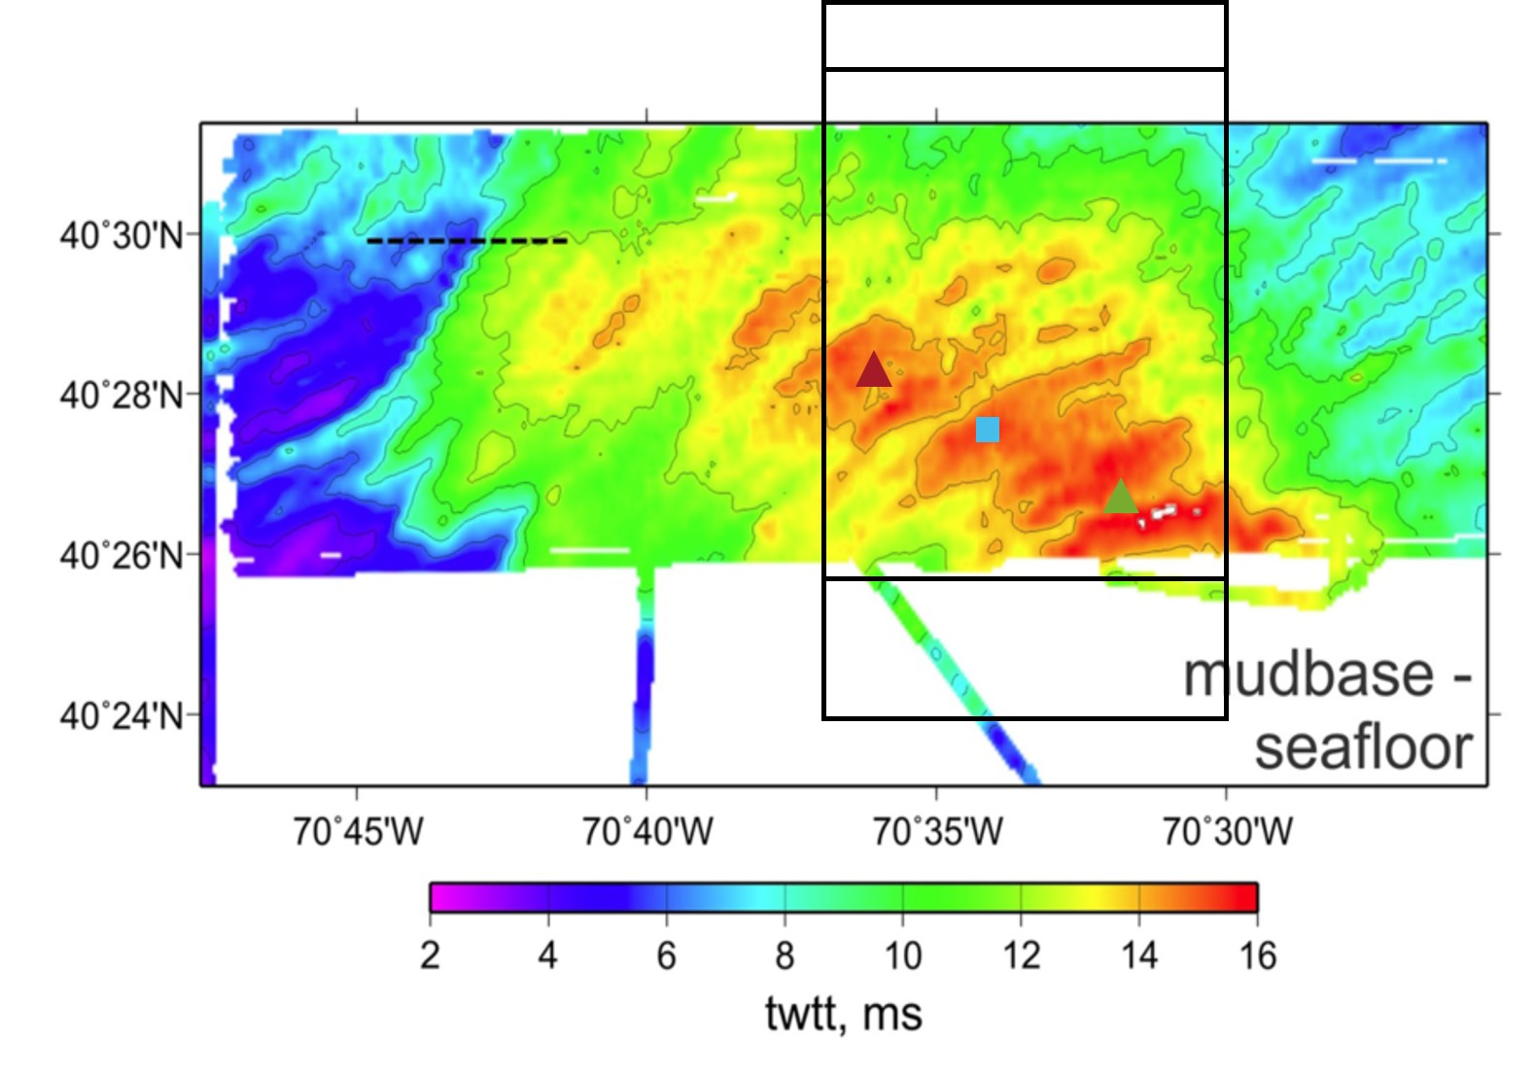
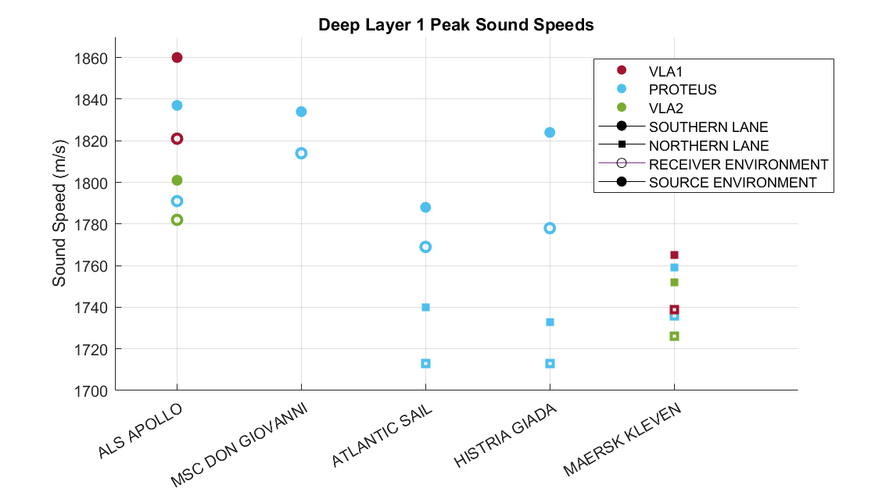
Bounding the problem
Mud thickness: ~3 m
Water depth: ~ 67 m
North:
NORTHERN LANE
Bound the range-dependent problem
Maximum Entropy Inversion
Receiver environment
Source environment
Mud thickness: 9.2 m
Water depth: 75 m
SOUTHERN LANE
Mud thickness: ~ 5 m
Water depth: ~ 80 m
P. S. Wilson, D. P. Knobles, and T. B. Neilsen, “Guest editorial an overview of the seabed characterization experiment,” IEEE Journal of Oceanic Engineering 45(1), 1–13 (2020). (See Fig. 2)
Notes:
However as shown in the figure on the left, this is a range dependent problem. Both the water depth and mud thickness varied throughout the region, but we used a prior ocean model with fixed parameters for the top three layers from the thickest part of the mud, even though sound from ships had to travel across variable mud thicknesses.
To bound the uncertainty of the deep layer sound speeds, a test was done on several select ships where the top three layers and water depth was instead held fixed with the parameters at the source location.

Slide 15
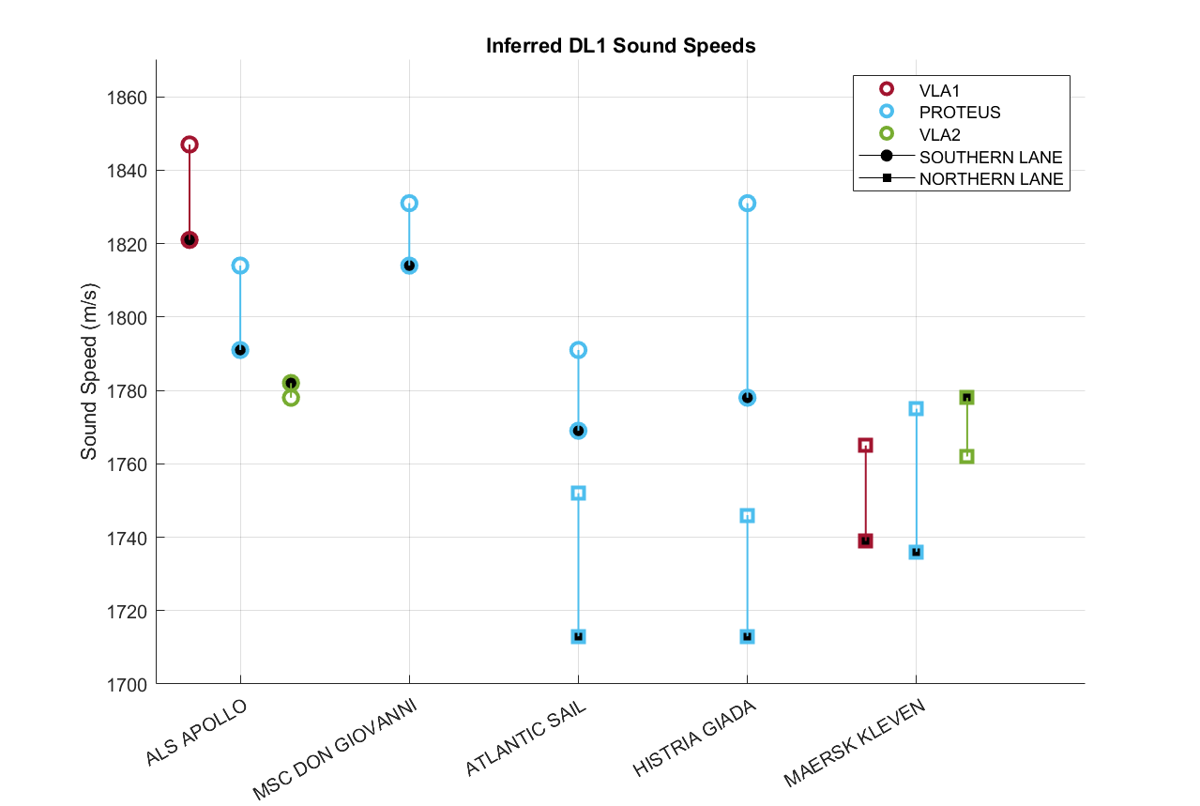
Bounding the problem
Closed points match previous sound speed plot (receiver environment)
Open points are results from using source environment
Notes:
The results of this study are shown in the plot where the filled points represent the original deep layer one estimated sound speeds with the receiver environment and the unfilled points indicating the source environment was used. Once again the colors represent the arrays and the circles show the southern versus squares for the northern lane.
There is a definitive shift in the estimated sound speeds depending on which environment, but they are in the same direction for all but one case. Again, the sound speeds are grouped, supporting the claim of heterogeneity in the seabed.

Slide 16
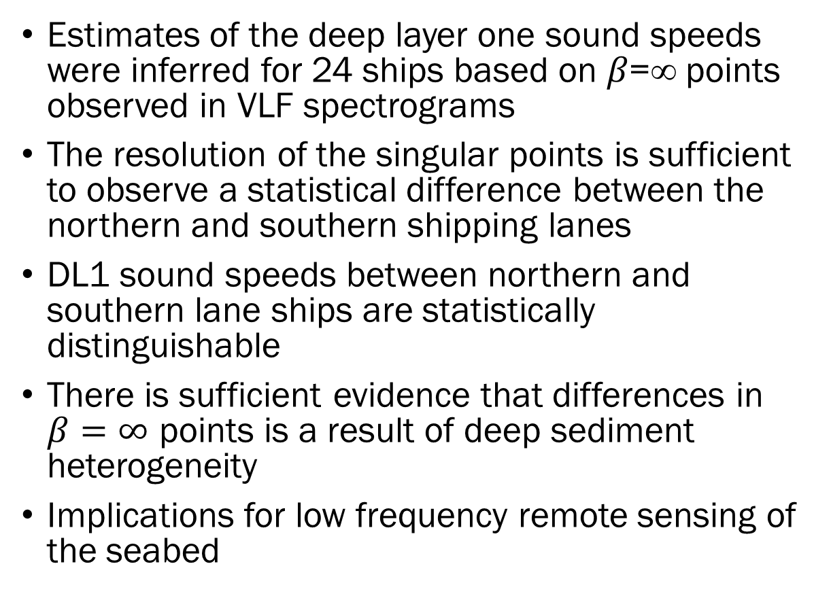
Conclusion
Estimates of the deep layer one sound speeds were inferred for 24 ships based on 𝛽=∞ points observed in VLF spectrograms
The resolution of the singular points is sufficient to observe a statistical difference between the northern and southern shipping lanes
DL1 sound speeds between northern and southern lane ships are statistically distinguishable
There is sufficient evidence that differences in $β=∞$ points is a result of deep sediment heterogeneity
Implications for low frequency remote sensing of the seabed
Notes:
In conclusion:
Implications: This analysis provides a way for estimation of deeper layers in the environment through a passive approach that is less of an endevor than large-scale seismic studies and direct measurements.

Slide 17
Acknowledgments
The Office of Naval Research for funding the project
Contract number: N00014-22-P-2007
Those involved with SBCEX 22
Dr. David Knobles and Dr. Traci Neilsen for mentorship throughout this analysis

Slide 18
Conclusion
Estimates of the deep layer one sound speeds were inferred for 24 ships based on 𝛽=∞ points observed in VLF spectrograms
The resolution of the singular points is sufficient to observe a statistical difference between the northern and southern shipping lanes
DL1 sound speeds between northern and southern lane ships are statistically distinguishable
There is sufficient evidence that differences in $β=∞$ points is a result of deep sediment heterogeneity
Implications for low frequency remote sensing of the seabed
Notes:
In conclusion:
Implications: This analysis provides a way for estimation of deeper layers in the environment through a passive approach that is less of an endevor than large-scale seismic studies and direct measurements.

